Slide 1
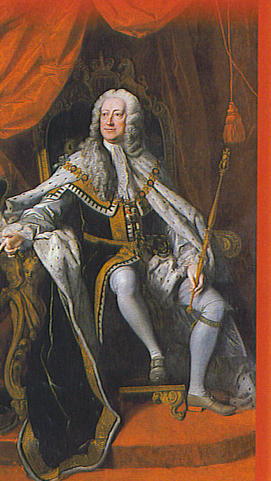
Write
EQ: After a year everything is going great, so what’s the problem?
PT: List reasons everything may not be “great” in the GA colony.
King George II

Slide 2
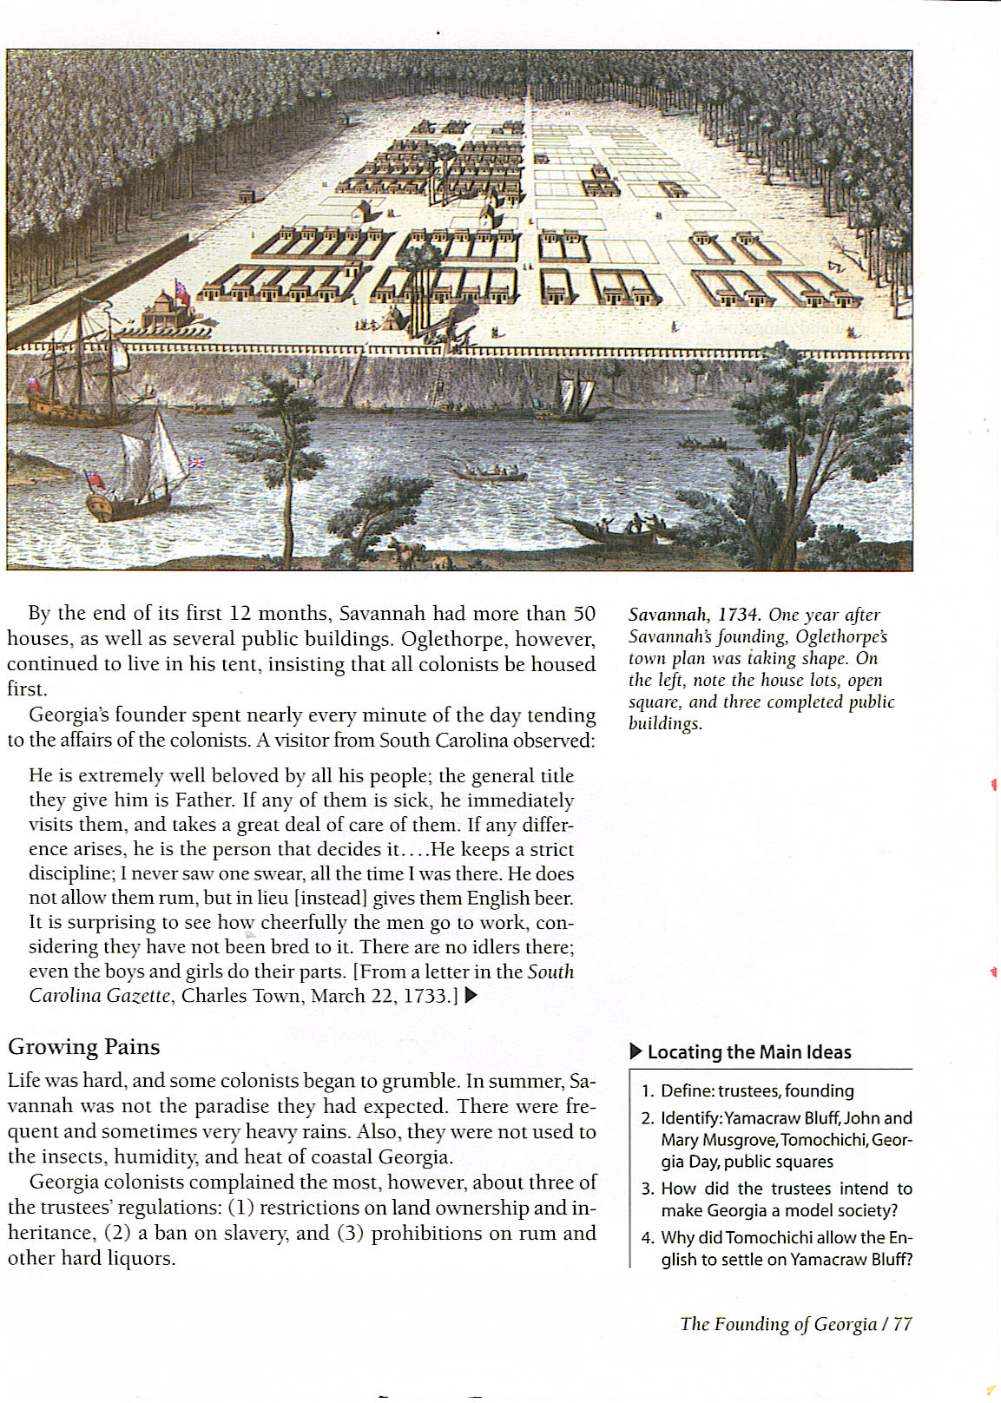
Write
Savannah 1734
Oglethorpe’s Tent

Slide 3
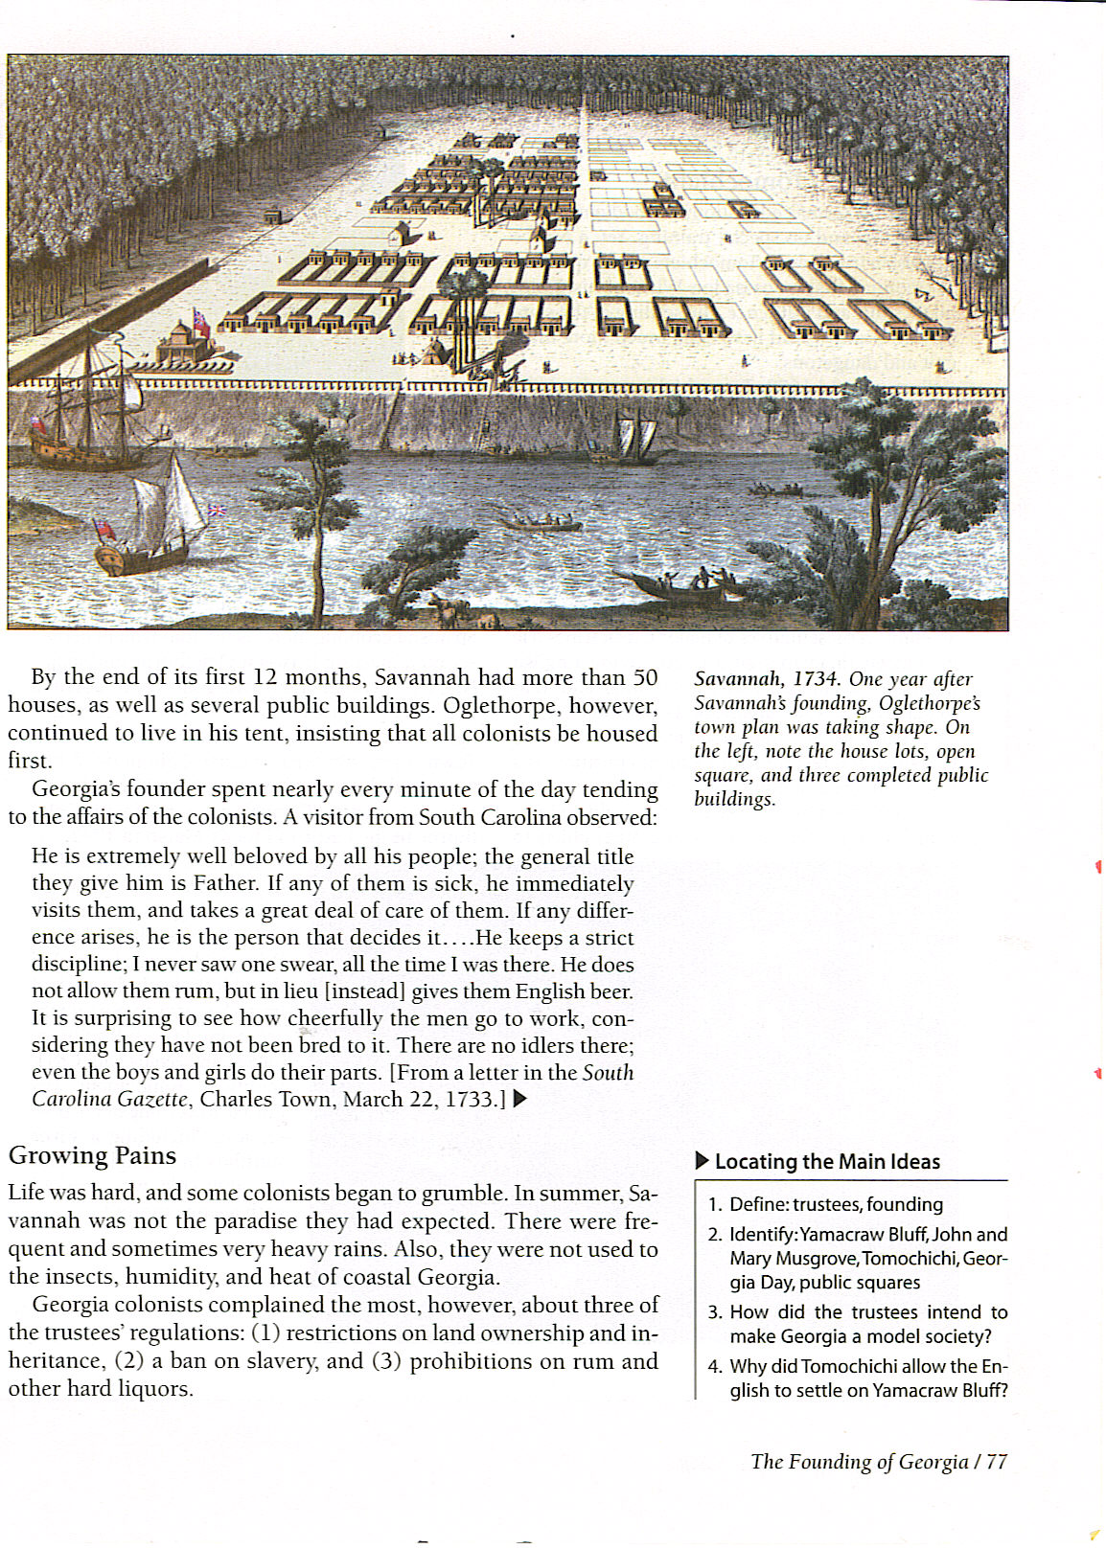
Read

Slide 4
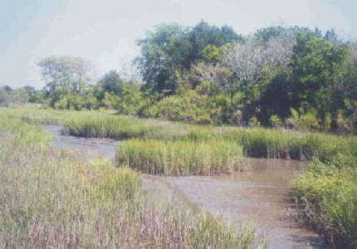
- Summer 1733 – Coastal GA
Write
- life was hard
- frequent heavy rains
- insects
- high humidity
- heat

Slide 5
Trustee Restrictions
Write
1. Restrictions on land ownership and inheritance
- trustees (TRUST) did not want a rich upper class
- land ownership limited
- adult male came on charity
- town lot for house
- 50 acres land
- 45 in country - 5 edge of town

Slide 6
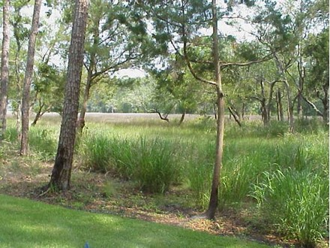
Write
- adult male – not charity
- 50 acres
- plus 50 ac. per servant up to 500 ac.
- poorly drained land
- couldn’t sell or lease land
- if colonist left – land went back to (TRUST)

Slide 7
- most unpopular restriction
Write
- inheritance
- land could only pas to a male heir
- if a man died w/out a son
- land went back to (TRUST)
- redistributed to another family

Slide 8
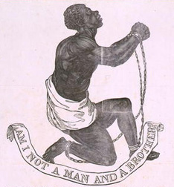
Write
2. ban on slavery in GA colony
- ban -to prohibit – not allow
- JO and other (TRUST) against slavery
- others argued slavery was allowed in all other colonies

Slide 9
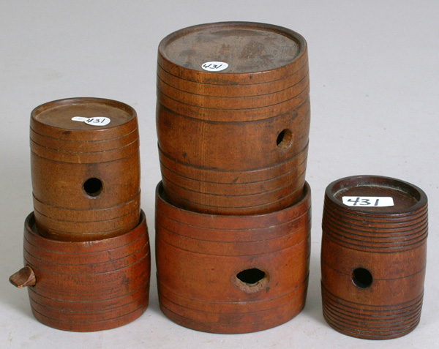
Write
3. prohibition (not allowed) of rum and other hard liquor
Colonists could drink ALE & WINE only
- colonists ignored the ban

Slide 10
- Summer 1734 - JO returns to England w/
Write
- Chief Tomochichi (C TOM) nephew – Tooanahowi & delegation of Creeks
- Creeks meet king & queen
- pledge friendship
- appearances create a stir

Slide 11
- Jo reports on colony
Write
- asked for gov. funding for colony
- forget charity for needy
- GA now important buffer against SP & FR & their Indian allies
- Parliament agreed to build forts along GA’s southern border

Slide 12
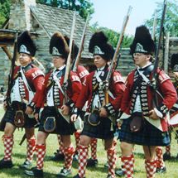
Darien – GA’s 1st Fort
Write
- 150 Scottish Highlanders
- GA’s southern border
- mouth of Altamaha River – fort & small settlement

Slide 13
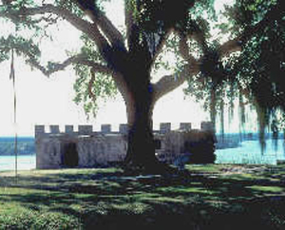
- Feb. 1736 Fort Frederica, St. Simon Island
Write
- became GR BRIT’s largest military base
- JO & C TOM picked more sites for forts
- SP upset – GR BRIT building forts on “debatable land” – land SP stilled claimed
- JO & Moral de Sanchez, FL governor, formed a treaty

Slide 14
Indian Relations Important
Write
- needed Indian trade
- SC traders cheated Indians
- as well as trading rum to Indians
- GA needed Indian’s as allies if war broke out with SP
- JO ordered to regulate trading with Indians

Slide 15
Trade With Indians:
Write
license
2. pay fee
3. Agree to follow rules
Goal:
- treat Indians fair
- created an official exchange rate for animal skins & other trade items

Slide 16
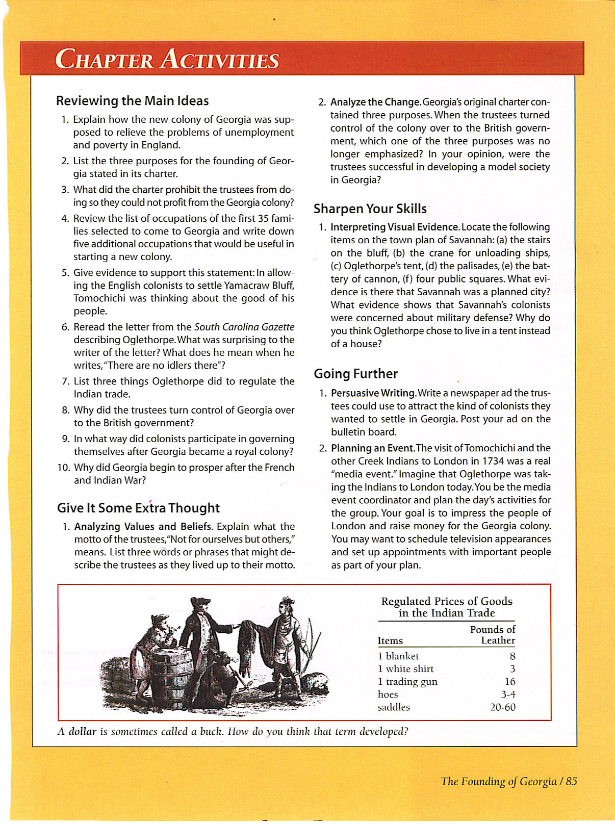
Discuss
Hmm… I wonder where the term “ a buck” came from?

Slide 17
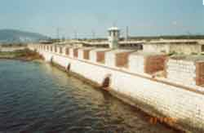
Discuss
- most trading took place in GA’s backcountry (upcountry) - unsettled area far inland from coast
- better control trade
- 1736 - JO built Fort Augusta on Savannah River

Slide 18
Discuss
Reflection:
What do you think Spain feels by Great Britain’s increased military fortification along its southern border?

