Slide 1
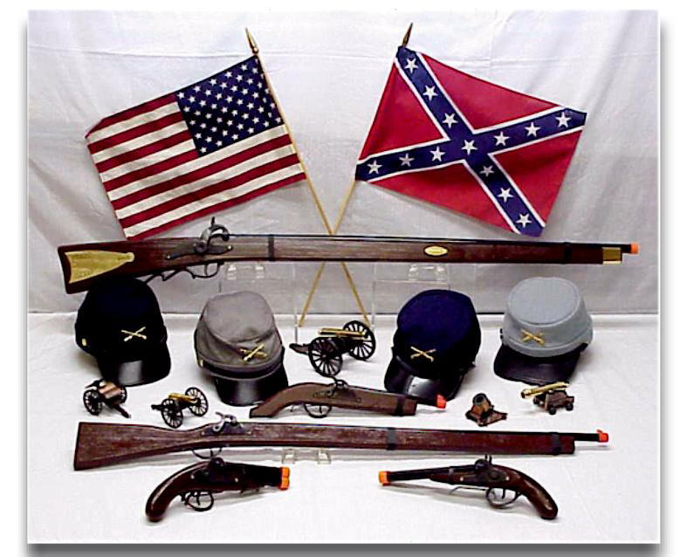
CIVIL WAR
SS8H6 The student will analyze the impact of the Civil War and Reconstruction on Georgia

Slide 2
SS8H6 The student will analyze the impact of the Civil War and Reconstruction on Georgia
NULLIFICIATION
Tariff: a tax on imported goods designed to keep out competition.
In the 1800s, Congress passed several protective tariffs.
The tariffs raised the price of goods sold in the US.
Because the South had so few factories & had to import most products, southerners were particularly hard hit by the tariffs and blamed the tariffs for their poor economy.

Slide 3
SS8H6 The student will analyze the impact of the Civil War and Reconstruction on Georgia
John C. Calhoun (Vice President of the U.S.) wrote in The South Carolina Exposition allowing the nullification (or prevention of enforcement of) a federal law.
Calhoun believed that nullification provided a way for the South to protect slavery and not lose their power as time passed.
By 1832 South Carolina challenged the tariff enforcement and had a convention to nullify tariffs.

Slide 4
SS8H6 The student will analyze the impact of the Civil War and Reconstruction on Georgia
South Carolina also refused to collect any tariff taxes.
South Carolina also threatened to secede from the Union and create their own separate government.
No Southern states supported South Carolina at the time.
A compromise settled the crisis and Congress passed a new tariff that gradually reduced the tariff duties to earlier rates.
South Carolina repealed its nullification of the earlier tariff.

Slide 5
http://player.discoveryeducation.com/index.cfm?guidAssetId=881C0C63-A46E-4688-8912-51BCADCB0E53&blnFromSearch=1&productcode=US

Slide 6
SS8H6 The student will analyze the impact of the Civil War and Reconstruction on Georgia
POP QUIZ

Slide 7
SS8H6 The student will analyze the impact of the Civil War and Reconstruction on Georgia
The early 1800s belief of some people that a state could refuse to enforce a federal law was known as
Absolution.
Justification.
Nullification.
Ratification.

Slide 8
SS8H6 The student will analyze the impact of the Civil War and Reconstruction on Georgia
The early 1800s belief of some people that a state could refuse to enforce a federal law was known as
Absolution.
Justification.
Nullification.
Ratification.

Slide 9
SS8H6 The student will analyze the impact of the Civil War and Reconstruction on Georgia
In 1832, the state of South Carolina attempted to exert its state’s rights by nullifying a Congressional tariff. Who had said that this action was permitted?
John. C. Calhoun
Coach Calhoun
Zachary Taylor
Henry Clay

Slide 10
SS8H6 The student will analyze the impact of the Civil War and Reconstruction on Georgia
In 1832, the state of South Carolina attempted to exert its state’s rights by nullifying a Congressional tariff. Who had said that this action was permitted?
John. C. Calhoun
Coach Calhoun
Zachary Taylor
Henry Clay

Slide 11
SS8H6 The student will analyze the impact of the Civil War and Reconstruction on Georgia
Missouri Compromise
In 1819, the U.S. had 22 states.
11 were slave states (states that did allow slavery), and 11 were free states (states that did not allow slavery).
This mean that the Senate had an equal number of senators form slave & free states.
*However, in the House of Representative, the free states had more representatives than the slave states.

Slide 12
SS8H6 The student will analyze the impact of the Civil War and Reconstruction on Georgia
Missouri Compromise
In 1819, Missouri territory applied for statehood as a slave state.
After a great deal of debate, Congress adopted the Missouri Compromise in 1820.
Main entered the Union as a free state, and Missouri entered as a slave state.

Slide 13
SS8H6 The student will analyze the impact of the Civil War and Reconstruction on Georgia
Missouri Compromise
The measure also prohibited slavery north of 36◦ 20’ latitude, which was Missouri’s southern border.
This compromise kept balance of power between the free states & slave states in the Senate and provided a temporary solution to the slavery question.

Slide 14
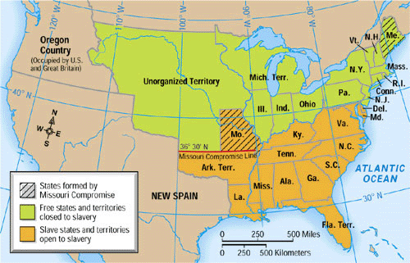
SS8H6 The student will analyze the impact of the Civil War and Reconstruction on Georgia

Slide 15
http://player.discoveryeducation.com/index.cfm?guidAssetId=10A0EE83-08A3-4C8D-A5CC-13F60BEA8097&blnFromSearch=1&productcode=US

Slide 16
SS8H6 The student will analyze the impact of the Civil War and Reconstruction on Georgia
POP QUIZ

Slide 17
SS8H6 The student will analyze the impact of the Civil War and Reconstruction on Georgia
The purpose of the Missouri Compromise was to
Return slaves captured in free states to slave states
Allow slavery in Maine but not in Missouri.
Maintain a balance of slave and free states.
Let Missouri have slavery until 1850.

Slide 18
SS8H6 The student will analyze the impact of the Civil War and Reconstruction on Georgia
The purpose of the Missouri Compromise was to
Return slaves captured in free states to slave states
Allow slavery in Maine but not in Missouri.
Maintain a balance of slave and free states.
Let Missouri have slavery until 1850.

Slide 19
SS8H6 The student will analyze the impact of the Civil War and Reconstruction on Georgia
Compromise of 1850 and The Georgia Platform
By late 1849, the population of California was over 100,000, enough to ask for statehood.
In 1850, there were 15 slaves states & 15 free states.
If CA became a state, the balance in the Senate between slave states and fee states would change.
For 8 months, “The Great Debate” raged as Congress tried to agree on what to do about C.A.

Slide 20
SS8H6 The student will analyze the impact of the Civil War and Reconstruction on Georgia
Compromise of 1850 and The Georgia Platform
Senator Henry Clay of Kentucky proposed a compromise bill.
Clay Compromise of 1850 was passed by Congress.
The compromised offered something to please both North and South.

Slide 21
SS8H6 The student will analyze the impact of the Civil War and Reconstruction on Georgia
Benefits for the North
California came into the Union as a free state.
Slave trading was ended in the District of Columbia.
Texas gave up its idea of annexing (to apprehend of attach) New Mexico, thus taking that territory away from a slave state.

Slide 22
SS8H6 The student will analyze the impact of the Civil War and Reconstruction on Georgia
Benefits for the South
The territories of New Mexico and Utah would determine whether they wanted to be slave or free.
The residents of the District of Columbia could determine whether they wanted to be slave or free.
Congress would pass a law (the Fugitive Slave Act) stating that slaves who ran away to free states would be retuned to their owners.

Slide 23
SS8H6 The student will analyze the impact of the Civil War and Reconstruction on Georgia
Many Georgians did not like the Compromise of 1850.
Democrat Congressman Howell Cobb, Whigs Alexander Stephens, and Robert Toombs asked the citizens of GA to accept it.
Partly because of their persuasiveness, the “Georgia Platform” supporting the compromise was adopted at the convention held in the state capital of Milledgeville.

Slide 24
SS8H6 The student will analyze the impact of the Civil War and Reconstruction on Georgia
A Constitutional Union party was formed with Cobb and Toombs. Cobb was elected governor in 1851.
The purpose of the Constitutional Union party in GA was to get acceptance of the Compromise of 1850.

Slide 25
SS8H6 The student will analyze the impact of the Civil War and Reconstruction on Georgia
POP QUIZ

Slide 26
SS8H6 The student will analyze the impact of the Civil War and Reconstruction on Georgia
Which was a result of the Compromise of 1850?
Owning slaves was forbidden in Washington, D.C.
Slavery was permitted in the new state of C.A.
Importation of slaves from Africa was declared illegal.
Runaway slaves had to be returned to southern owners.

Slide 27
SS8H6 The student will analyze the impact of the Civil War and Reconstruction on Georgia
Which was a result of the Compromise of 1850?
Owning slaves was forbidden in Washington, D.C.
Slavery was permitted in the new state of C.A.
Importation of slaves from Africa was declared illegal.
Runaway slaves had to be returned to southern owners.

Slide 28
SS8H6 The student will analyze the impact of the Civil War and Reconstruction on Georgia
Which outcome resulted from the Compromise of 1850?
Slavery was eliminated in the District of Columbia.
C.A. was allowed to enter the Union as a free state.
Texas was allowed to annex New Mexico extending slavery into that territory.
Popular sovereignty was established, allowing states to vote on whether or not to have slavery.

Slide 29
SS8H6 The student will analyze the impact of the Civil War and Reconstruction on Georgia
Which outcome resulted from the Compromise of 1850?
Slavery was eliminated in the District of Columbia.
C.A. was allowed to enter the Union as a free state.
Texas was allowed to annex New Mexico extending slavery into that territory.
Popular sovereignty was established, allowing states to vote on whether or not to have slavery.

Slide 30
SS8H6 The student will analyze the impact of the Civil War and Reconstruction on Georgia
The “Georgia Platform: was a statement supporting?
States’ rights.
Popular sovereignty.
The Compromise of 1850.
Slavery throughout the United States.

Slide 31
SS8H6 The student will analyze the impact of the Civil War and Reconstruction on Georgia
The “Georgia Platform: was a statement supporting?
States’ rights.
Popular sovereignty.
The Compromise of 1850.
Slavery throughout the United States.

Slide 32
SS8H6 The student will analyze the impact of the Civil War and Reconstruction on Georgia
The purpose of the Constitutional Union party in GA was to ?
Preserve the Constitution.
Replace the Republican party in the South.
Get acceptance of the Compromise of 1850.
Illustrate the differences between the North and South.

Slide 33
SS8H6 The student will analyze the impact of the Civil War and Reconstruction on Georgia
The purpose of the Constitutional Union party in GA was to ?
Preserve the Constitution.
Replace the Republican party in the South.
Get acceptance of the Compromise of 1850.
Illustrate the differences between the North and South.

Slide 34
SS8H6 The student will analyze the impact of the Civil War and Reconstruction on Georgia
The purpose the Fugitive Slave Act was to ?
Require slaves to have citizenship papers in order to obtain jobs.
Prevent slaves from testifying against whites in court trials.
Require slaves that had run away to go back to their owners.
Prevent slaves from having group gathering or meetings.

Slide 35
SS8H6 The student will analyze the impact of the Civil War and Reconstruction on Georgia
The purpose the Fugitive Slave Act was to ?
Require slaves to have citizenship papers in order to obtain jobs.
Prevent slaves from testifying against whites in court trials.
Require slaves that had run away to go back to their owners.
Prevent slaves from having group gathering or meetings.

Slide 36
SS8H6 The student will analyze the impact of the Civil War and Reconstruction on Georgia
Title your Paper Pre-Civil War
Write 6 Facts based on the video about some important factors that lead up to the Civil War.
http://player.discoveryeducation.com/index.cfm?guidAssetId=82155FFA-1425-4595-BEA8-10662FDF80CF&blnFromSearch=1&productcode=US
CAUSES OF THE CIVIL WAR

